Slide 1
The Text Annotation and Research Tool (TART)

Slide 2
Outline
Pragmatics & Corpora
Speech/Dialogue-Act Annotation
The DART Approach
From DART to TART
Observations & Issues
Intended Features
Potential Applications

Slide 3
Pragmatics & Corpora
dearth of pragmatically annotated corpora
existing ones mostly designed for Language Engineering purposes, rather than linguistic ones
corpus-pragmatics predominantly limited to concordancing on fixed expressions, e.g.
discourse markers (DMs), request structures, politeness formulae
research on “functional profiles” (Adolphs 2008) still in its infancy

Slide 4
Speech/Dialogue-Act Annotation (1)
no agreed standards, despite valid attempts by Discourse Resource Initiative (DRI)
latest proposals for ISO standard (Bunt et al. 2010)
misguided, as purely semantics-oriented
treat dialogue acts as “update operations on information states”
derivatives of Searle’s taxonomy (e.g. Kirk 2013) lack expressiveness, due to limited number of categories
DAMSL/SWBD-DAMSL popular
but unwieldy & subjective (Weisser 2014)
more or less only suitable for manual annotation

Slide 5
Speech/Dialogue-Act Annotation (2)
the DART scheme
further development of the SPAAC scheme
most advanced, yet generic, scheme to date
designed for automatic annotation
currently 57 individual speech-act labels
around 200 combinations possible
continuously updated and improved

Slide 6
The DART Approach (1)
DART = Dialogue Annotation and Research Tool
annotation comprises a number of distinct linguistic levels
syntax element
attributes
speech-act
mode: semantico-pragmatic markers or IFIDs
topic: semantic information
polarity: presence or absence of ‘surface’ negation
using/joining information from different levels allows direct recognition or inference of speech act(s)

Slide 7
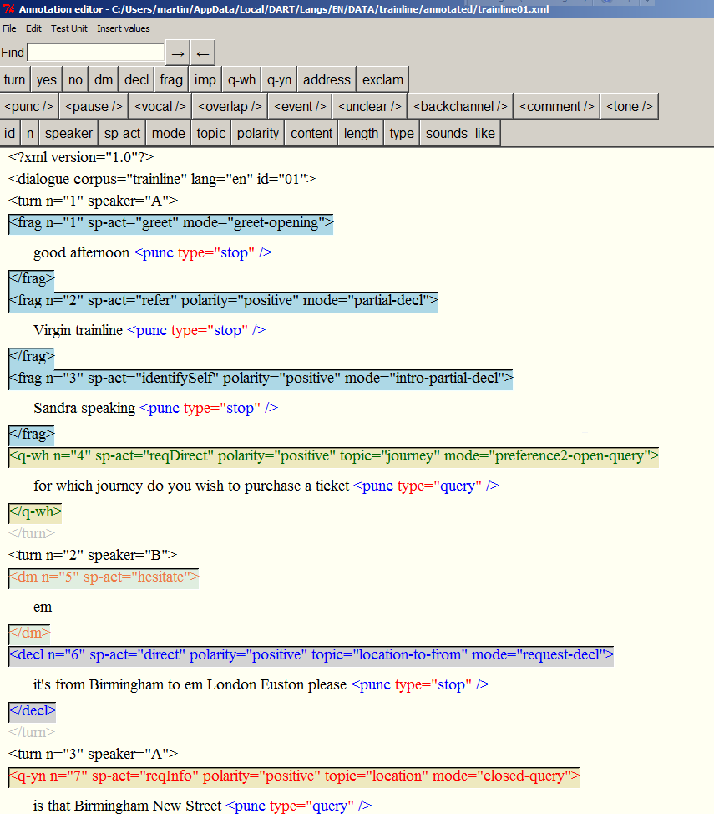
The DART Approach (2)
syntactic category
mode = semantico-pragmatic markers/‘IFIDs’
topic = semantic info
speech act(s)
(surface) polarity

Slide 8
The DART Approach (3)
combination of annotation & research functionality
annotation functionality
resources can be modelled on different levels
often user-customisable
facilitates creating corpora for/from new domains
research functionality
creation of speaker speech-act profiles
n-gram analyses
concordancing
interaction between functionality levels can be used for cyclical refinement of corpora
e.g. link between concordancing, frequency analyses, profiles & editing

Slide 9
From DART to TART (1) – Essential Considerations
is it possible to apply the notion of speech acts to written language in the same way?
which elements of spoken language can be seen as identical to those of written language?
which elements are sufficiently different & require re-modelling?

Slide 10
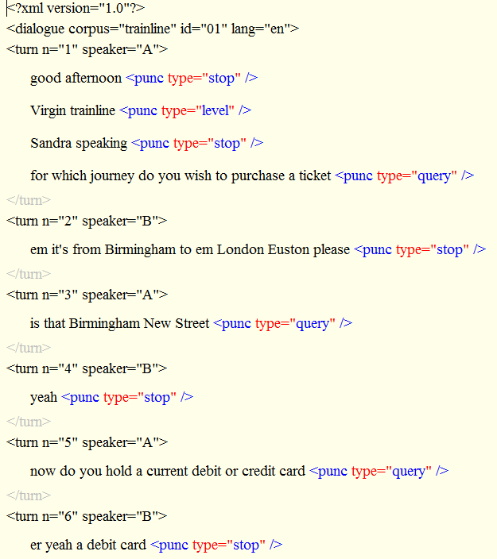
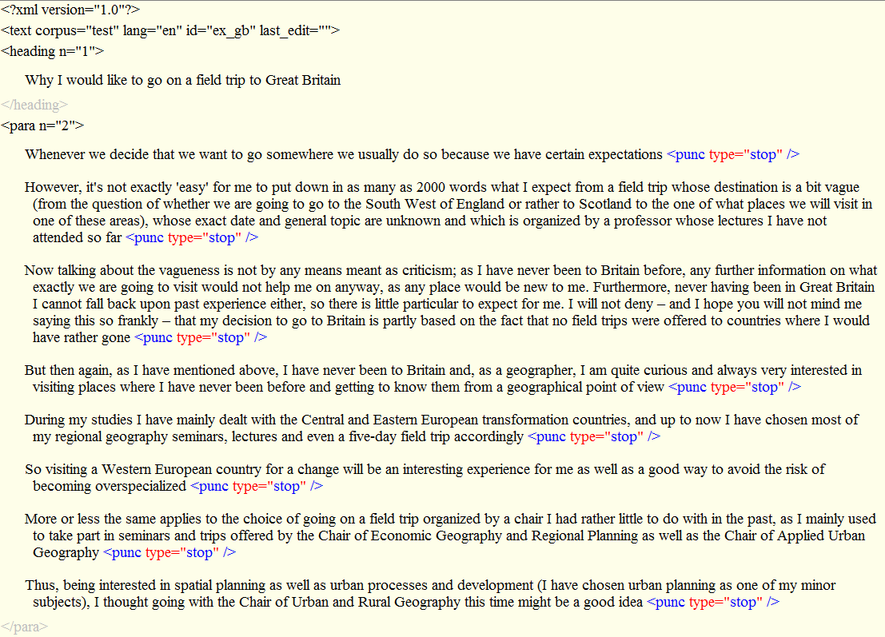
From DART to TART (2) – Speech Acts in Written Language
essentially, pragmatic meaning expressed at the same level, i.e. c-units
c-units defined as “[…] clausal and non-clausal units […] that […] cannot be syntactically integrated with the elements that precede or follow them.” (Biber et al. 1999: 1070)
speech-act identification revolves around correct identification of units
problematic, due to structure of written language

Slide 11
From DART to TART (3) – Syntactic (Pre-)Processing Issues
in spoken language
essentially two unit types, turn & c-unit
pauses + syntax useful indicators for identifying unit boundaries
in written language:
more diverse structural types, due to register/genre variability
chapters/sections, paragraphs, titles/headings, c-units
how to treat special types, e.g. abstracts, affiliations, references in academic articles?

Slide 12
From DART to TART (3) – Syntactic (Pre-)Processing Issues
punctuation potentially unreliable & idiosyncratic
especially minor punctuation marks, such as commas
underuse by native speakers of English
incorrect use by native and non-native speakers of English, e.g. between subject & verb
status of colon & semi-colon?
embedded or separate units?
sentence adverbials (handled as deictic references in DART)
quoted speech
lists
equations/formulae
reference entries

Slide 13
Intended Analysis Features (1)
filtering options
by speaker or group in DART
by sections/paragraph types in TART
pragmatics-related analysis features
speech acts by syntactic types (as in DART)
non-pragmatics-related analysis features
n-grams based on units (as in DART)

Slide 14
Intended Analysis Features (2)
features ported from the Text Feature Analyser (by corpus/file)
unit statistics, including syllable counts
complexity indicators (raw & stopword filtered): TTRs, mean unit length, StdDev unit length, lexical density, FOG index
feature counts by unit & paragraphs
freely definable
based on regular expression patterns associated with labels
hyperlinked to concordancer for investigation/testing

Slide 15
Potential Applications
investigation of pragmatic/communicative features/strategies in
different text types/domains
learner language
expert vs. lay persons’ writing
improved ‘MDA’, based on functional units
analysis of textual complexity & formulaic language

Slide 16
References
Adolphs, S. 2008. Corpus and context: Investigating pragmatic functions in spoken discourse. Amsterdam: John Benjamins Publishing Company.
Allen, J. and Core, M. 1997. Draft of DAMSL: Dialog Act Markup in Several Layers. Available from: ftp://ftp.cs.rochester.edu/pub/packages/dialog-annotation/manual.ps.gz .
Bunt, H., Alexandersson, J., Carletta, J., Choe, J., Fang, A., Hasida, K., Lee, K., Pethukova, V., Popescu-Belis, A., Romary, L., Soria, C. & D. Traum. 2010. Towards and ISO standard for dialogue annotation. In Proceedings of the Seventh conference on International Language Resources and Evaluation (LREC 2010). 2548-2555.
Jurafsky, D., Shriberg, E. and Biasca, D. 1997. Switch­board SWBD-DAMSL Shallow-Discourse-Function Annotation Coder Manual. Available from: <http://www.stanford.edu/~jurafsky/ws97/ics-tr-97-02.ps>
Leech, G. and Weisser, M. (2003). Generic Speech Act Annotation for Task-Oriented Dialogue. In Archer/Rayson/Wilson/McEnery (Eds.) Proceedings of the Corpus Linguistics 2003 Conference. Lancaster University: UCREL Technical Papers, vol. 16.
Kirk, J. 2013. Beyond the Structural Levels of Lan­guage: An Introduction to the SPICE-Ireland Corpus and its Uses. In Cruickshank, J. and McColl Millar, R. (eds.) 2013. After the Storm: Papers from the Forum for Research on the Languages of Scotland and Ulster triennial meeting, Aberdeen 2012. Aberdeen: Forum for Research on the Languages of Scotland and Ireland, 207-32.
Weisser, M. 2014. Speech act annotation. In Aijmer, K. & Rühlemann, C. (Eds.). Corpus Pragmatics: a Handbook. Cambridge: CUP.
Weisser, M. 2014. DART – the Dialogue Annotation and Research Tool. Submitted to Corpus Linguistics and Linguistic Theory.
Weisser, M. 2014. The DART Manual. Application manual to accompany the Dialogue Annotation & Research Tool. Available from <http://martinweisser.org/publications/DART_manual.pdf>.
Weisser, M. 2013; forthcoming 2016. Corpora. In Barron, A., Gu, Y. and Steen, G. (Eds.). The Routledge Handbook of Pragmatics. London: Routledge.
Weisser, M. 2010. Annotating Dialogue Corpora Semi-Automatically: a Corpus-Linguistic Approach to Pragmatics. Habilitation (professorial) thesis, Univer­sity of Bayreuth.
Weisser, M. 2007. The Text Feature Analyser – a Flexible Tool for Comparing Different Levels of Text Complexity. In Schmied/Haase/Povolná (Eds.). Complexity and Coherence: Approaches to Linguistic Research and Language Teaching. Göttingen: Cuvillier Verlag. pp. 49-63.

