Slide 1
The Simple Corpus Tool
Martin Weisser Research Center for Linguistics & Applied Linguistics Guangdong University of Foreign Studies weissermar@gmail.com

Slide 2
Outline
Genesis of the Tool
Feature Overview
Illustration of Individual Features
Annotation
Concordancing
N-gram Analysis
Feature Extraction

Slide 3
Genesis of the Tool
2001 –2002: SPAAC (A Speech-Act Annotated Corpus of Dialogues) Project
semi-automated annotation of 1,200+ transactional dialogues
majority of data ‘unpublishable’, due to restrictions imposed by BT
2013 release of SPAADIA corpus (version 1)
user query about best viewing option
SPAADIA Concordancer
further development into Simple Corpus Tool, including extended options for
analysis & feature extraction
annotation
v. 1 released Oct 2013
current version 1.5

Slide 4
Feature Overview (1)
corpus editing & analysis tool
includes:
annotation editor
concordancer
n-gram analysis
feature counting
flexible & configurable options
supports full Perl regular expressions

Slide 5
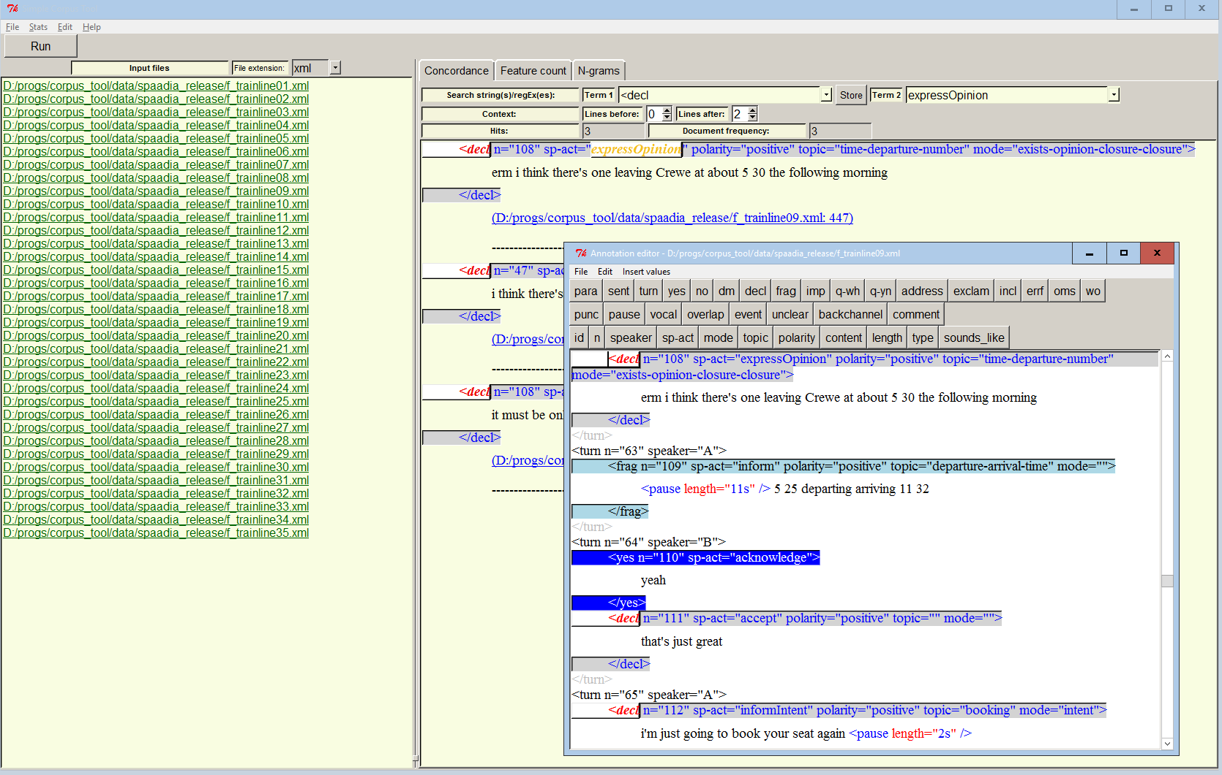
Feature Overview (2)
Concordancer; results hyperlinked to editor
Feature counting options/definitions
N-gram analysis tool
corpus files editable
Extension filter
Input files workspace

Slide 6
Annotation (1)
editor linked to various analysis features
cyclical refinement of annotations
convenient extraction of annotated features
file encoding assumed to be UTF-8 (e.g. allows insertion of phonetic characters)
XML/pseudo SGML annotation for XML & text files
annotation resources fully configurable
containing elements (block & inline)
empty elements
optional default attributes
categorised cascading menus for values
colour-coding for tags

Slide 7
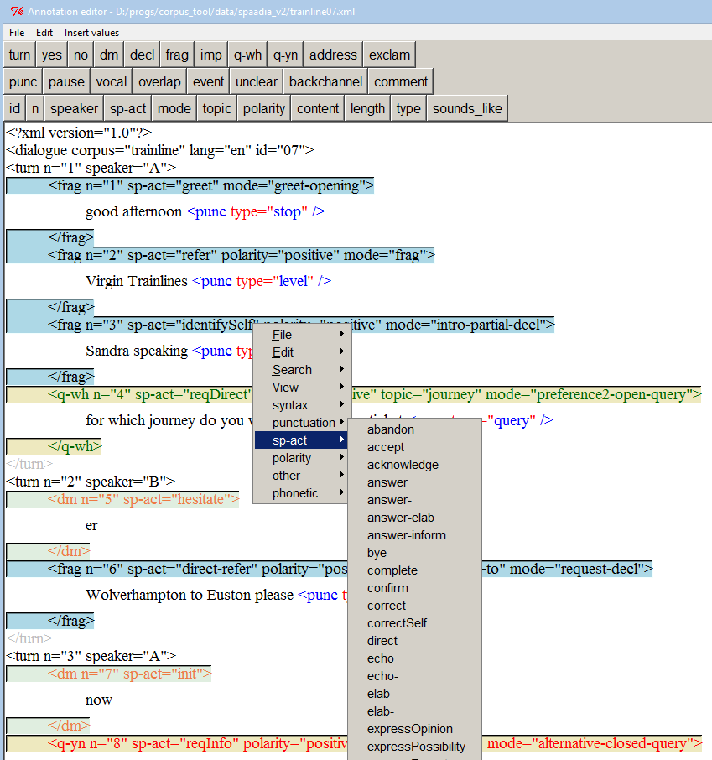
Annotation (2)
containing elements
empty elements
attributes
colour coding: syntactic class empty elements
values (sub-categorised)

Slide 8
Concordancing (1)
line-based concordancer
assumes that main structural units & text are separate
context set to n lines before or after
concordancing on tags or textual content (2 potential search terms)
displays dispersion
full Perl regex support
option for storing commonly used regexes
SPAADIA/DART features
colour coding
pre-defined unit tags and speech-act attributes
hits hyperlinked to editor for
adding annotations
modifying existing annotations

Slide 9
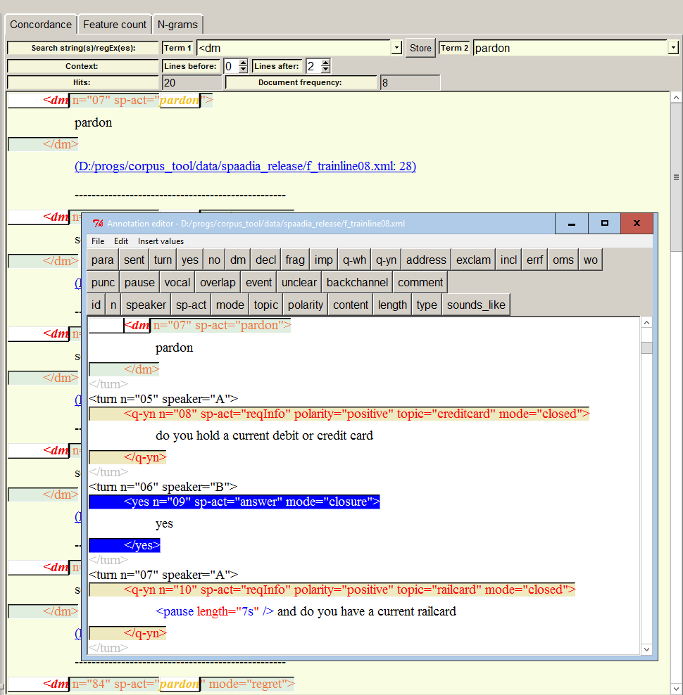
Concordancing (2)
search term 1
search term 2
dispersion
context
settings
hyperlink to editor
hits

Slide 10
N-gram Analysis (1)
hyperlinked to concordancer
include relative frequencies & dispersion
‘optimised’ for spoken language: option for
excluding fillers
re-interpolating into concordances
efficient regex filtering

Slide 11
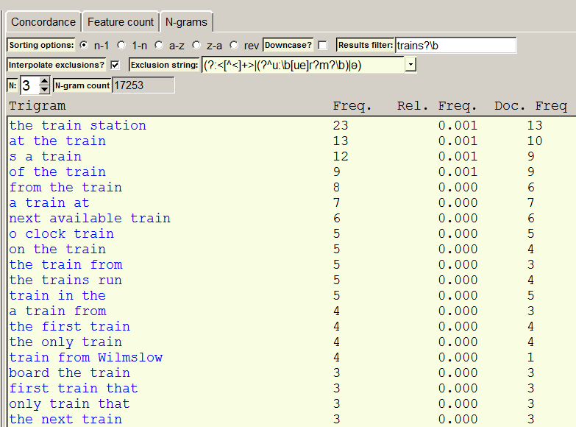
N-gram Analysis (2)
case handling
output filter
sorting options
n-gram length
relative frequencies & dispersion
n-gram counter
hyperlinked n-grams; prime concordancer
customisable exclusion options for producing cleaned n-grams; can be re-interpolated into concordancer

Slide 12
Feature Extraction (1)
basic feature: word count per file
can be filtered
annotations automatically removed
exceptions (e.g. anonymised names) can be specified
advanced ‘feature label :: pattern’ pairings
ad hoc definitions in ‘Feature definitions’ window
can be loaded from & saved to files
built-in regex pattern evaluation & error reporting
convenient ‘export’ to Excel/Calc for further analysis (e.g. frequency norming)

Slide 13
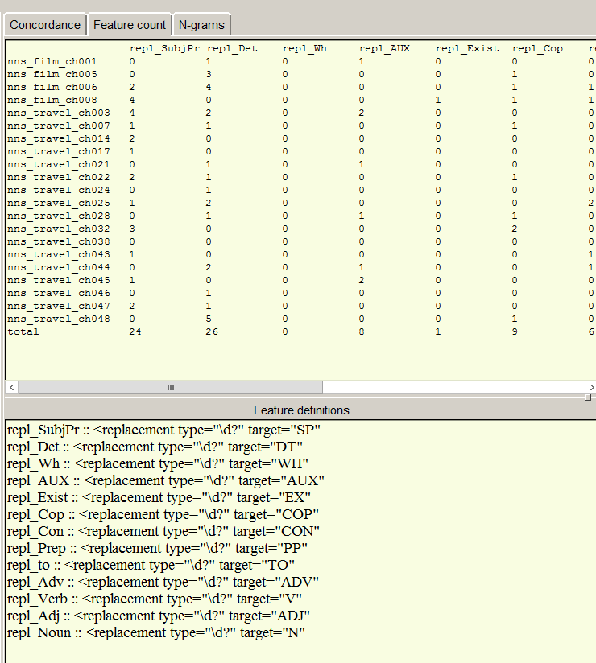
Feature Extraction (2)
feature counts per file
file names → row headings
feature definition patterns
feature labels → column headings

Slide 14
Future Extensions
concordancing on text within specified tags
n-gram list comparison
collocations?
exposing more customisation options
user requests

